Slide 1
Python map() Function
DVT101 – Lecture 18
- By Dataverse Tutorials

Slide 2
Introduction
What is map() function
Why element-wise transformation is needed
Problems with traditional loops
How map() makes code concise

Slide 3
What is map() ?
map() applies a function to every element
Works on iterables (list, tuple, set)
Returns a map object (iterator)
Lazy evaluation

Slide 4
Internal Working of map()
map() applies a function to every element
Works on iterables (list, tuple, set)
Returns a map object (iterator)
Lazy evaluation

Slide 5
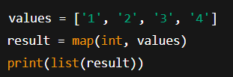
Example 1 – String to Integer Conversion
Convert string numbers to integers
Using built-in int() with map
Convert map object to list

Slide 6
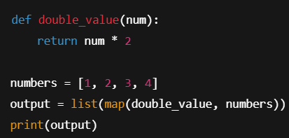
map() with Custom Function
Custom transformation logic
Function reuse
Cleaner than loops

Slide 7

map() with lambda
No need for separate function
Short and readable
Ideal for one-line transformations

Slide 8
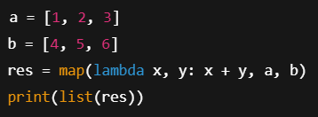
map() with Multiple Iterables
Multiple lists allowed
Parallel iteration
Stops at shortest iterable

Slide 9
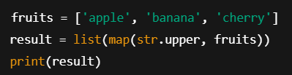
Text Processing – Uppercase Conversion
map with string methods
No lambda required
Clean and fast

Slide 10
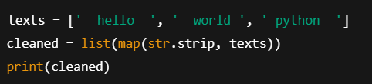
Data Cleaning – Remove Whitespaces
Clean raw text data
map with strip()
Very common preprocessing step

Slide 11

Temperature Conversion (Real-World Example)
Mathematical transformation
Scientific computation
Engineering use case

Slide 12
map() vs for loop
map is functional
for loop is imperative
map is more concise

Slide 13
Summary & Key Takeaways
map applies function element-wise
Returns iterator
Memory efficient
Widely used in DS & ML

Slide 14


